Slide 1
Birth asphyxia
Dr Sachith Mettananda
Department of Paediatrics
Reproductive Health Module
2019

Slide 2
Asphyxia is reduced oxygen delivery to the tissues
Birth/ Perinatal asphyxia –
  Condition of impaired gas exchange or inadequate blood flow that leads to
  persistent hypoxemia and hypercarbia
  occurs in temporal proximity to labor and delivery
? depressed at birth

Slide 3


Oxygen delivery to the fetus
Maternal blood O₂ saturation
Placental blood flow
Gas exchange across the placenta
O₂ delivery to the fetal tissues

Slide 4
Causes
Caused by any maternal, placental, cord or fetal factors that
  decrease maternal oxygen saturation
  decrease placental blood flow
  decrease gaseous exchange across the placenta
  increase fetal oxygen requirement

Slide 5
Causes
Maternal
  hypoxia from respiratory / cardiovascular disease
  hypotension
  infections
  vascular disease
Placental
  insufficiency
  infarction
  abruption
  hydrops

Slide 6
Causes
Cord
  accidents- prolapse, entanglement, true knot, compression
  abnormal umbilical vessels
Fetal
  anaemia
  IUGR
  post maturity
  infections

Slide 7



Pathophysiology
Compensatory changes in blood flow to maintain O2 delivery to vital organs brain, heart, adrenals
When the asphyxia is prolonged
Tissue hypoxia
Acidosis
Myocardial depression
Bradycardia
Hypotension
Cardiac output
Failure to perfuse vital organs
Permanent tissue damage

Slide 8
Epidemiology
The incidence of perinatal asphyxia is dependent on the definition used, the ability to accurately make the diagnosis, and the quality of obstetrical care
Incidence 6-8 per 1000 live births (Swiss study)

Slide 9
Clinical features
In the fetus - features of fetal distress
  bradycardia
  meconium stained liquor
  CTG - Minimal variability, Decelerations
  Fetal scalp blood sampling – acidosis

Slide 10
Clinical features
Newborn
  Low Apgar score
 | 2 | 1 | 0
Appearance | pink | centrally pink; extremities blue | blue/pale
Pulse rate | >100 | <100 | absent
Grimace | cry | some | nil
Activity | well flexed | some flexion | limp
Respiration | good, regular | hypoventilation | absent

Slide 11
Clinical features
Newborn
  Low Apgar score (5 minute)
  Apgar 8 – 10 : No asphyxia
  Apgar 5 – 7 : Mild asphyxia
  Apgar 3 – 4 : Moderate asphyxia
  Apgar 0 – 2 : Severe asphyxia
  Umbilical artery acidosis
  pH <7.0 or base deficit ≥12 mmol/L
  Brain injury in MRI
  Multisystem organ failure

Slide 12
Clinical features and effects of asphyxia
  Hypoxic ischemic encephalopathy
    Altered tone, Depressed level of consciousness and
    Seizures
    Stage 1 – hyperalert, hyperactive reflexes
    Stage 2 – lethargic, hypotonic, seizures
    Stage 3 – coma, decerebrate, absent reflexes

Slide 13
Clinical features and effects of asphyxia
  CNS
    IC haemorrhage
    Seizures
    Cerebral edema
  CVS
    Myocardial ischemia
    Hypotension
  RS
    Respiratory distress
    Pulmonary hypertension
    Apnoea

Slide 14
Clinical features and effects of asphyxia
  Renal
    Acute tubular necrosis
    Acute kidney injury
  Heaptic
  Elevated ALT
  GIT
    Feed intolerance
    NEC
  Haematological
    DIC
    Thrombocytopenia

Slide 15
Clinical features and effects of asphyxia
  Adrenal
    Adrenal haemorrhages
  Metabolic
    Hyper and Hypoglycaemia
    SIADH
    Hyponatraemia
    Hypocalcaemia

Slide 16
Management
Anticipation and preparation at delivery
Resuscitation – at birth
Post resuscitation care – in a SCBU

Slide 17
Initial Evlauation
Clinical – Respiratory, Cardiac and Neurological status
Investigations
  FBC
  ABG
  Blood sugar
  Serum electrolytes
  Serum creatinine
  ALT/ AST
  Septic screen
  US Brain

Slide 18
Management – Therapeutic hypothermia
Therapeutic hypothermia
  Standard treatment in term and late preterm infants
  Hypothermia decreases the rate of apoptosis and suppresses production of mediators known to be neurotoxic
  Started within 6 hours
  Maintain for 72 hours
  Therapeutic hypothermic range of 33 to 35°C
  Therapeutic hypothermia is initiated for infants with
    gestational age (GA) of ≥35 weeks
    pH of ≤7.0 or base deficit ≥16 mmol/L
    moderate to severe encephalopathy (10 min APGAR =<5)
    OR need for ongoing resuscitation at least for 10 minutes

Slide 19
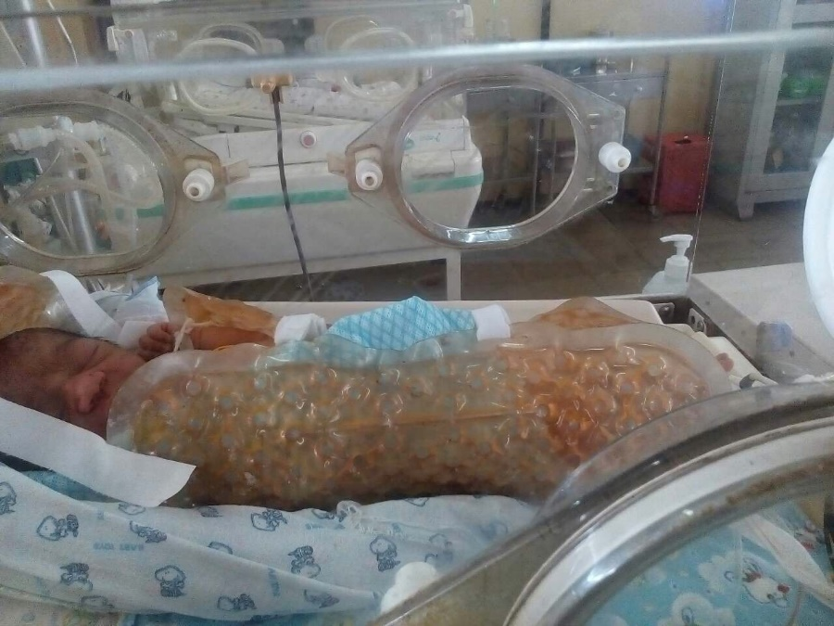
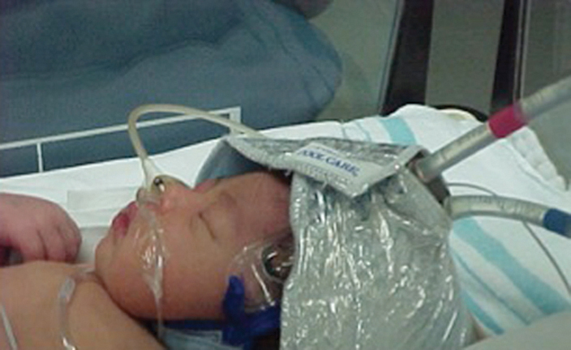
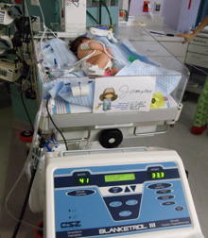

Slide 20
Management – Supportive care
Respiratory support – SIMV / CPAP
Maintain perfusion / blood pressure – inotropes (dopamine/ dobutamine/ milrinone) and hydrocortisone (in severe cases)
Fluid and electrolyte management – may need fluid restriction
Nutrition – enteral / parenteral
Seizures – anticonvulsant
Treatment of hypoglycaemia and electrolyte imbalance
Monitoring

Slide 21
Complications
  Cerebral palsy - spastic quadriplegic
  Mental retardation
  Auditory and visual defects
  Epilepsy
  Behavioural problems

Slide 22
Prognosis
Poor prognostic factors
  Severe metabolic and cardiopulmonary complications
  Prematurity
  Severe encephalopathy (Stage 3 )
  Low Apgar score at 20 minutes
  Absence of spontaneous breathing at 20 minutes
  Persistent abnormal neurological signs at 2 weeks
  Severe MRI and EEG abnormalities

